Slide 1


Dungeons & Dragons: Monster Codex
Logan Roe

Slide 2


Project Overview
Subject Matter and Why?:
API selected:
Investigation:
Solutions:
Application:
Future Goals:

Slide 3
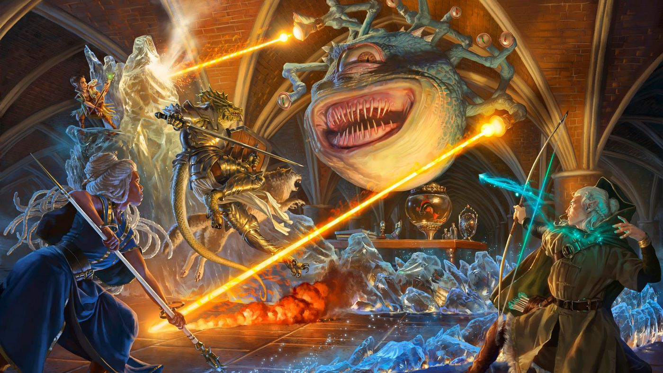
What is Dungeons and Dragons?
Dungeons and Dragons (D&D) is a renowned fantasy tabletop role-playing game where players embark on epic adventures in a richly imagined world.
The game revolves around storytelling, problem-solving, and strategic combat.
Players navigate challenges, interact with fantastical creatures, and uncover mysteries through rolling dice and making choices.

Slide 4
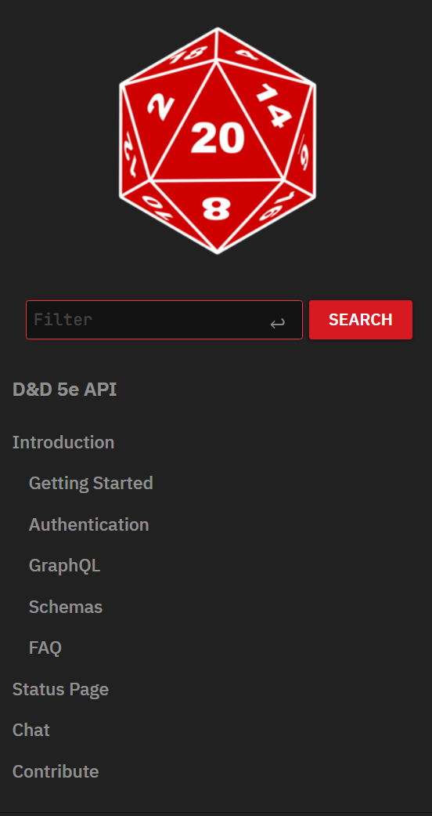
DND 5e API
https://www.dnd5eapi.co/
DND 5e API is a data rich free to use API, which is the prime reason for my choice.
The data is stored segmented by area (equipment, classes, monsters, magic items etc.).
Much of the Data is extremely Nested and has various data types to manage when working with it.

Slide 5
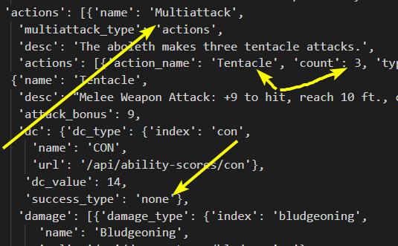
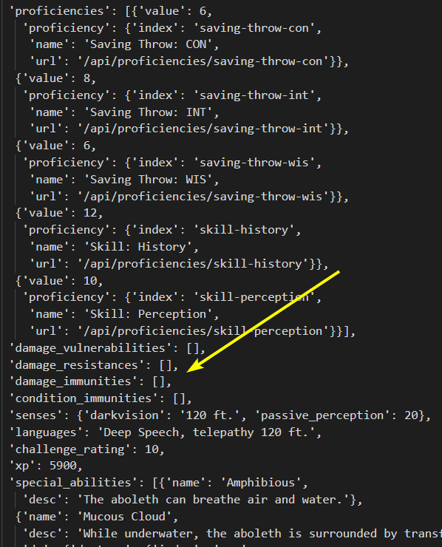
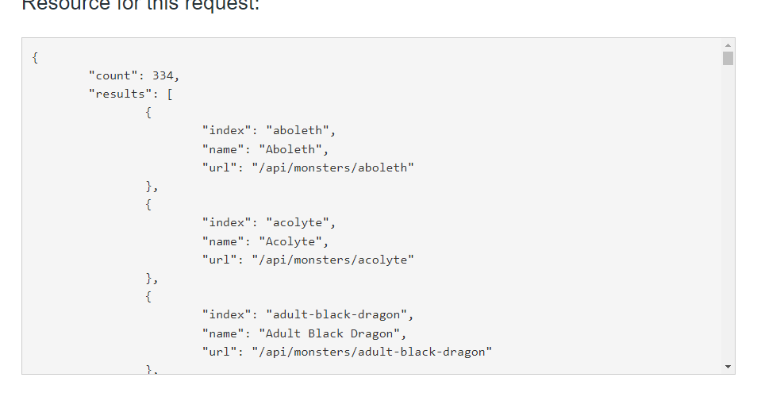
Data Challenges:

Slide 6
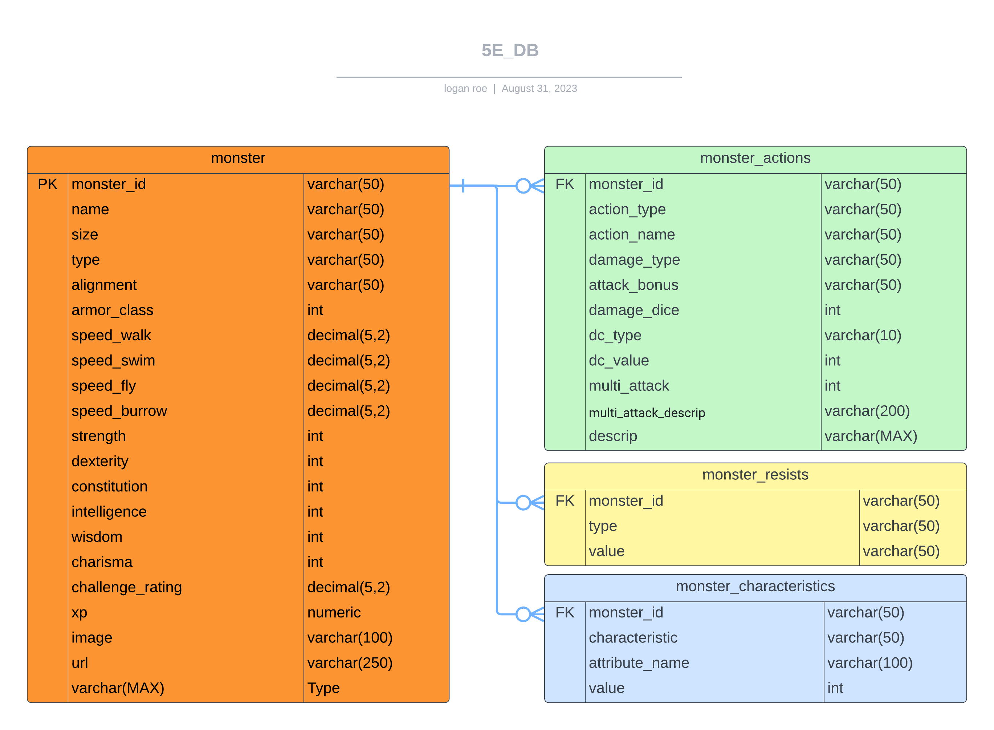
Data Normalization: A SQL Solution
Normalizing data in a database is crucial because it helps keep information organized, accurate, and efficient. It prevents repeating the same data and reduces mistakes. This makes it easier to ask questions and get useful answers from the database. Overall, it ensures that the database works well and provides reliable information.

Slide 7
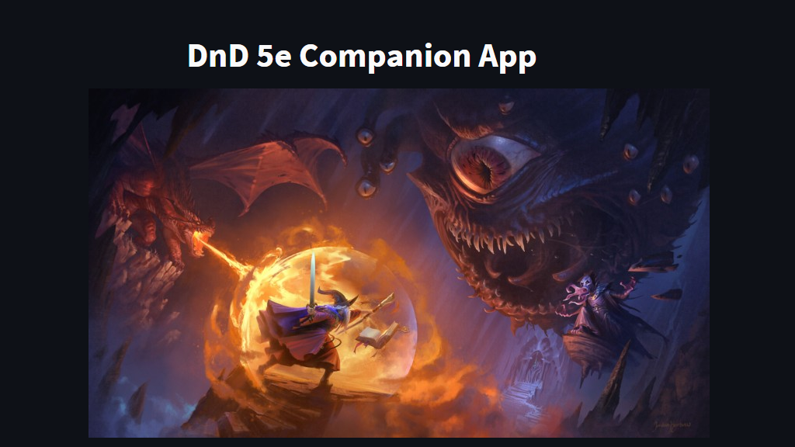
My Application

Slide 8
Summary : Future Goals
SQL and Base Class
Security
Content
Create “upsert” functionality without the need to recreate foreign keys post insert.
Look into dynamic check functions for the base class to refactor the length of the code.
Use the Streamlit secrets functionality to hide sensitive information.
Look into dynamic check functions for the base clas
Parse the remaining tables and upsert them:
Spells
Equipment/Magic Items
Classes/Character
Create character logic!
Add monster form!

